Slide 1

Space Flight in Anime: Fiction, Fact, and Fairy Tales
JP Burke & Conrad Schiff, PhD
Last revision – 7/17/15

Slide 2
About Us
JP Burke
Software Engineer at 2U Inc in New York City
Lifelong spaceflight enthusiast and all around nerd
Once took 7 hour trip to Florida to see 3:44am rocket launch
Conrad Schiff
Works at the Goddard Space Flight Center in Greenbelt, MD
Physicist by trade but plays an engineer on TV
Official disclaimer
All the opinions expressed by me are mine alone and do not reflect official positions of NASA or the Federal Government
JP is young and cool – he’ll discuss the anime
Conrad is old and grumpy – he’ll critique the physics

Slide 3
Anime and Space
Space and space flight are fixtures on many anime
Obviously the themes are entertainment and the human condition, but what about the physics?
Sometimes it is wrong
Sometimes it is very wrong – borders on fantasy & fairy tale
Occasionally it is right (or mostly so)
We will talk about three shows in detail
Gundam – Space Colonies at the Lagrange Point
Planetes – Debris removal in space/Kessler syndrome
Cowboy Bebop – Orbital motion and rendezvous
We’ll also poke, in passing, some of the worst shows

Slide 4
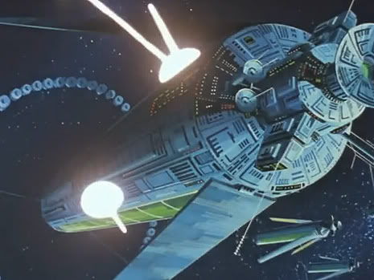
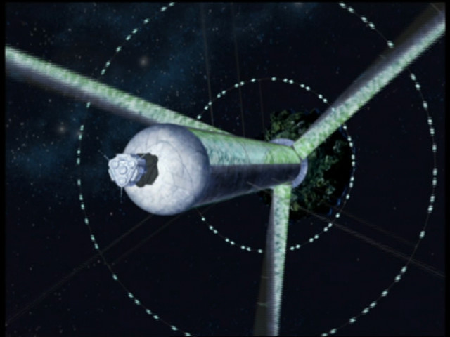
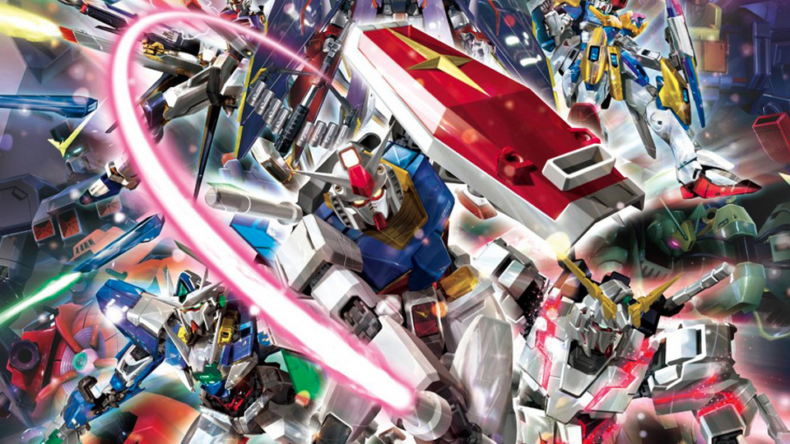

Slide 5
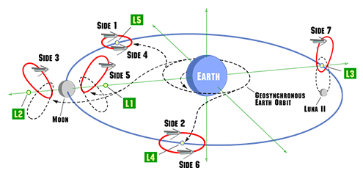

Slide 6
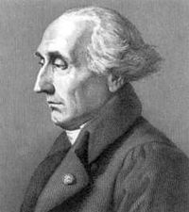
What Exactly is a Lagrange Colony?
Lagrange colony is a space station at one of the five Lagrange points -> so what’s a Lagrange point?
Imagine two equal mass planets sitting still
The gravitational pull is only equal halfway along the line joining them
Now let them rotate – a centrifugal force seems to be at work, pushing things outward
Joseph-Louis Lagrange
L4
L3
L1
L2
L5
Forces shown only for L1, L3, & L4 for simplicity

Slide 7
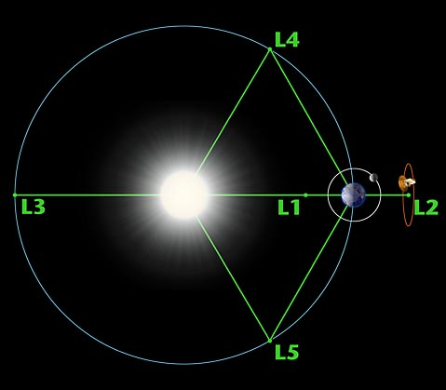
Lagrange Points
The Lagrange points are equilibrium points in a frame that rotates
Line joining the masses is now fixed
Equilibrium means that if you place something there with no velocity they will stay there (has to be perfect though)
Generally, the game is to have objects move around a particular point depending on what you want to do

Slide 8
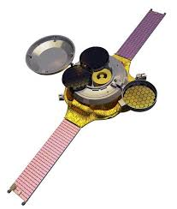
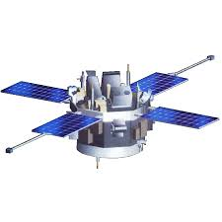
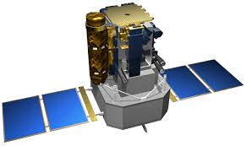
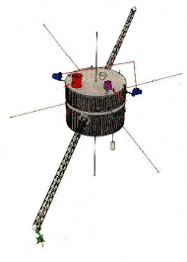
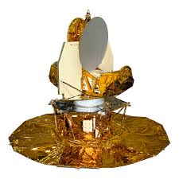
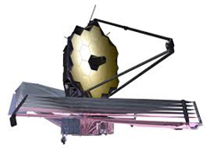
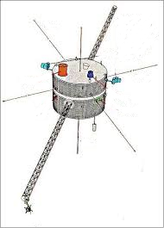
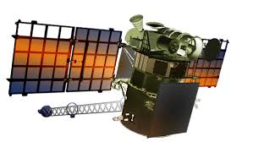
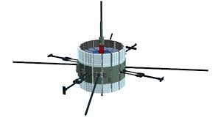
Does Gundam Get it Right?
Gundam wiki (http://gundam.wikia.com/wiki/Lagrange_Points) actually presents the Lagrange points
Do they get it right? For the most part yes, but…
L4 and L5 aren’t always stable
L1, L2, and L3 aren’t badly unstable
Lots of NASA missions use the L1 and L2 points in the Sun-Earth/Moon or Earth-Moon systems and manage to stay there for little fuel
System | L1 | L2
Earth-Moon | Apollo (free-return), Artemis¹ | Artemis¹
Sun-Earth/Moon | ISEE-3/ICE, WIND², SOHO, ACE³, Genesis, DSCOVER⁴ | WIND², WMAP^{2,3}, Geotail, JWST³
Simultaneous observations
Via lunar swingby/double lunar swingbys
C. Schiff trajectory/flight dynamics lead
Launched on Falcon-9

Slide 9
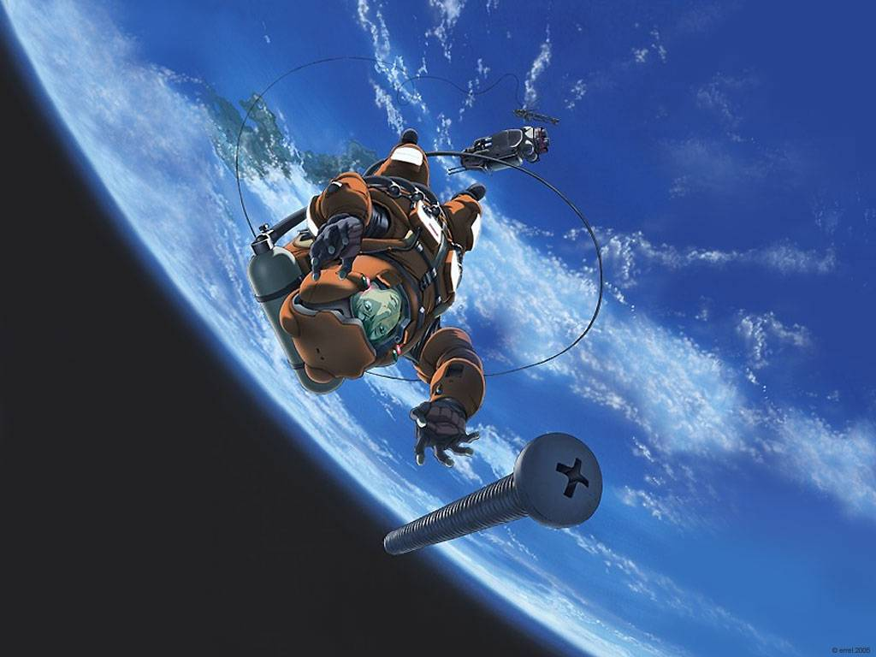

Slide 10
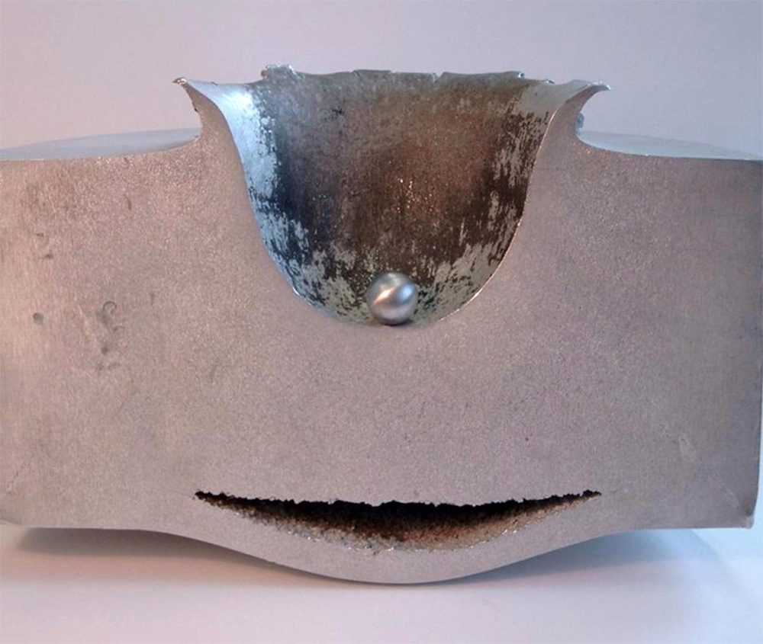

Slide 11
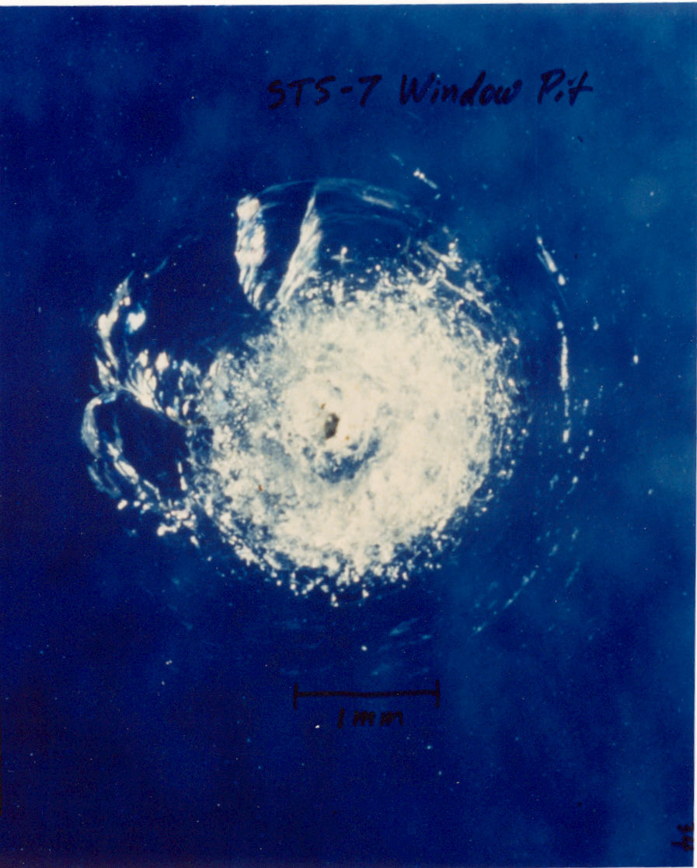

Slide 12
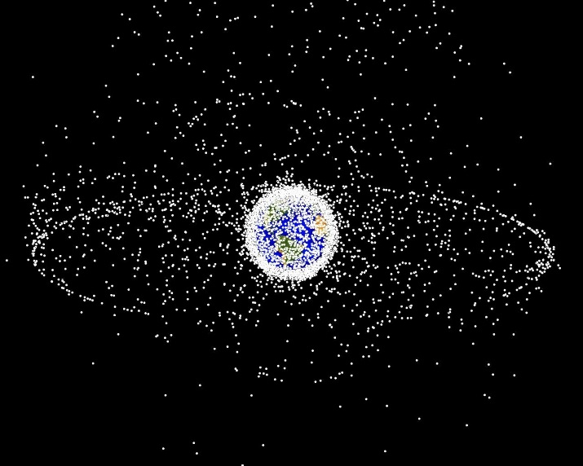
Is Planetes Right on Orbital Debris?
Unfortunately… yes
Orbital debris (http://orbitaldebris.jsc.nasa.gov/faqs.html)
Any man-made object that no longer serves a purpose
Distribution
21,000 objects > 10 cm in size
1 cm < 500,000 objects <10 cm
100 million < 1 cm
It looks crowded up there
Government regulations
NPR 8715.6A – Procedure for limiting orbital debris
UN Space Debris Mitigation Guidelines

Slide 13
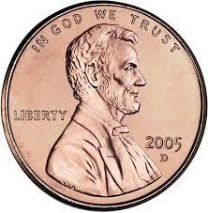
How about Planetes’ approach to the cleanup?
Makes for great drama but it does make it look easier than it is
Two major complications
Control errors – how well can we model what either the chaser or the target do?
Knowledge errors – how well can we know the relative position between the chaser and the target
Audience participation example – coin flip
What’s the probability that a fair coin comes up heads?
Does it matter before or after the flip?

Slide 14
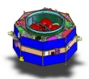



Orbital Debris in Action: MMS
Magnetospheric Multiscale (MMS) mission is a formation flying mission looking at magnetic reconnection
Night-side science (neutral sheet) bound by power (limits shadow duration)
Need to prevent close approaches (<4 km)
30-400 km
10-160 km
Maneuvers used to maintain formation against relative drift
Sun
Formation scale matches science scale

Slide 15
A War Story
How did you spend your Easter Sunday?
On April 2, MMS performed some calibration maneuvers
Small change in the orbit
Period changed by a tens of seconds (out of ~86400 seconds)
Size of the orbit changed by about 20 meters (out of ~42000 seconds)
On April 3 MMS received notice that MMS1 would be getting uncomfortably close to a piece of debris
Any guess what it was and when?
Spent April 3-April 5 trying to determine if we should maneuver
Late April 5 was the last chance
Complicated by the uncertainties involved
We opted not to maneuver

Slide 16
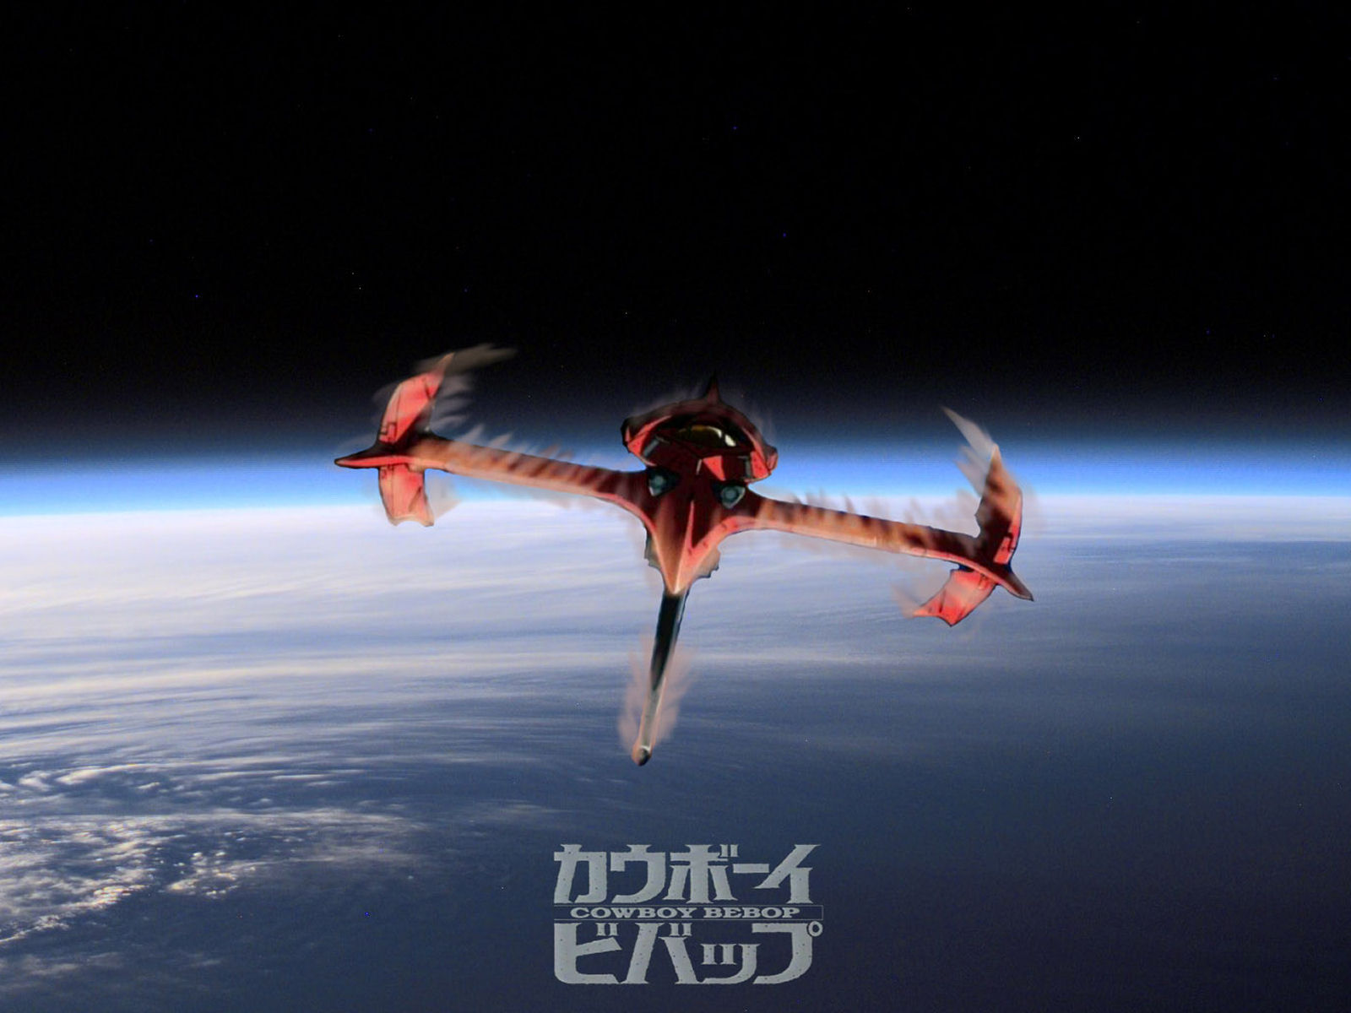

Slide 17
Some non-intuitive things about orbits?
Consider the following scenario:
An object in orbit around the Earth experiences atmospheric drag (decaying orbit)
It loses energy every orbit and gets closer and closer to the surface
Does it slow down or speed up?
How to change the closest point (periapse) in an orbit? How about the furthest point (apoapse)?

Slide 18
Does Cowboy Bebop Get it Right?
In the episode entitled ‘Wild Horses’, Spike and the Swordfish find themselves reentering Earth’s atmosphere without fuel
The animation has them thrusting in the direction of their motion hoping to raise their orbit
Unfortunately that just won’t work – it did raise the apogee though
Unless the vehicle is below 200 km it won’t reenter
Spike had plenty of time with or without fuel
So despite my real fondness for the show – Bebop didn’t get it right.

Slide 19
